Slide 1
Enhancing Data Security through Penetration Testing
Centennial College
Syed - 301318212
Deepak - 301304684
Nirojan - 300807665

Slide 2

Introduction
Importance of Data Security: In today's business environment, securing data and information is crucial for companies aiming to stay competitive. Adherence to security standards and regulations is imperative for all businesses.
Regulatory Procedures: Businesses implement various regulatory procedures such as security assurance, secure software engineering, proof of correctness, and penetration tests to strengthen protection measures.
Types of Penetration Testing Strategies:
Black Box Testing: Testers lack prior knowledge about the system being tested, simulating an external attacker's perspective.
Grey Box Testing: Testers possess minimal knowledge about the systems under test, providing a semi-knowledgeable approach.
White Box Testing: Testers are equipped with comprehensive knowledge about the systems being tested, allowing for an in-depth assessment of vulnerabilities.

Slide 3


History of Penetration Testing
With the rise of shared computer resources in the 1960s, security risks emerged, prompting the need for computer security.
The US Department of Defense initiated "tiger teams" in the 1970s to identify and address security holes, acknowledging the importance of securing computer systems.
James P. Anderson's introduction of "reference monitors" in the 1970s laid the foundation for enforcing authorized access relationships, contributing to secure system standards.
Dan Farmer and Wietse Venema's 1993 paper introduced the "uebercracker," a more elusive hacker, shaping the early foundations of penetration testing.
In 2003, OWASP provided the first penetration testing framework, evolving to version 4 in 2014, showcasing continual improvements to address evolving IT security challenges.

Slide 4

Methodology of Penetration Testing
Four Phases of Penetration Testing:
Planning: Scope, Approvals, Legal Compliance
Discovery: Testing, Vulnerability Analysis, Tools Used
Attack: Executing Attacks, Monitoring System
Reporting: Final Stage, Reporting Findings, Audience Catering

Slide 5
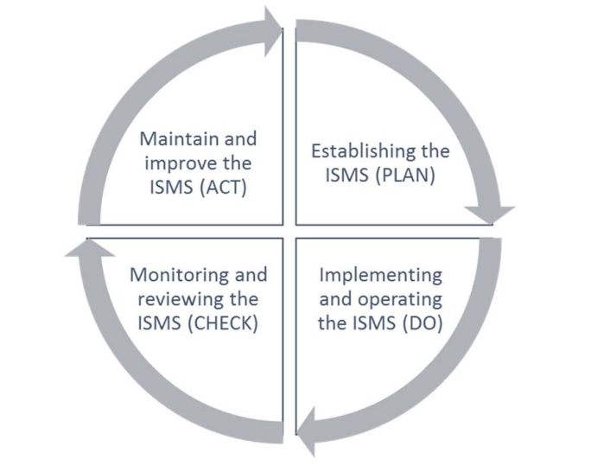
Information Security Management System (ISMS):
ISMS Overview:
Implements tailored security controls to address organizational needs.
Aims to minimize risks, ensuring business continuity and safeguarding information assets.
ISO27k Standards:
International standards applicable to businesses, government, and non-profits of all sizes.
(C-I-A) Traits:
Focus on Information Confidentiality, Integrity, and Service Availability.
PDCA Model Implementation:
Adopts the Plan-Do-Check-Act model for effective processes and continuous improvement.
Testing in ISMS:
Identifies vulnerabilities, contributing to risk assessments and guiding remedial actions.

Slide 6

Standards for Penetration Testing
Major Standard:
1. ISAAF: Integrated Security Assessment and Authorization Framework - Comprehensive security assessment and authorization framework.
2. NIST SP 800-115: National Institute of Standards and Technology Special Publication 800-115 - NIST guidelines for information security testing and assessments.
3. OSSTMM: Open Source Security Testing Methodology Manual - Open-source manual defining security testing methods.
4. OWASP: Open Web Application Security Project - Community-driven organization providing tools and resources for web application security.
5. PTES: Penetration Testing Execution Standard - Standardized methodology for conducting penetration tests and security assessments.

Slide 7

Penetration Testing Tools
Nmap: Network & OS Detection
Metasploit Framework: Creating/Executing Exploits
BeEF: Exploiting XSS Flaws
Shadow Security Scanner: Network Errors & Proxies
Nessus: Identifying Security Vulnerabilities
Wireshark: Network Analyzer
Zed Attack Proxy (ZAP): Web App Vulnerability Detection
Aircrack-ng: Assessing Wi-Fi Networks
Netcat: Computer Network Tool

Slide 8
Future Directions in Penetration Testing
Integration of AI & Machine Learning: Enhancing Efficiency & Automation
Specialized Methodologies for Cloud Computing & IoT

Slide 9
Challenges in Penetration Testing
Complexity in IT Infrastructures: Rapid Technological Advancements
Skills Shortage: Demands for Trained Penetration Testers
Ethical Considerations & Legal Frameworks: Responsible Practices

Slide 10

Conclusion
Penetration testing is the linchpin of cyber defense, countering evolving threats. Its historical evolution and adherence to standards underscore its critical role. Coupled with the Information Security Management System, it forms a robust defense. Future trends include AI integration, but challenges like skill shortages require continuous adaptation, ethics, and strategic cybersecurity investments.

